Slide 1

Introduction To Linear Regression
Abhishek Srivastava
Data Scientist
Tata Consultancy Services

Slide 2

Introduction To Linear Regression

Slide 3
Simple models for Prediction Linear Regression The Line of Best Fit Using Linear Regression for prediction Evaluate your Model – R square and Adjusted R squared Using all the features for prediction Bias and Variance
Key Points

Slide 4

Model 1: Mean Prediction
Mean prediction is simply predicting average of a quantitative parameter.
Ex: Predicting Sales of an item based on past records

Slide 5
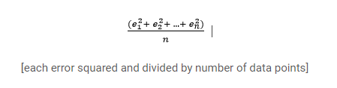
But How Good is my Prediction????
Check Mean Squared Error
The difference in the predicted and actual values divided by the number of observation will
give you mean error. Square each term so as to avoid cancelling out of the Positive and negative error.

Slide 6
Model 2: Average Sales by Location
We know that location plays a vital role in the sales of an item. For example, let us say, sales of car would be much higher in Delhi than its sales in Varanasi.

Slide 7

Linear Regression
Linear regression is the simplest and most widely used statistical technique for predictive modeling. It basically gives us an equation, where we have our features as independent variables, on which our target variable [sales in our case] is dependent upon.

Slide 8

Simple Linear Regression
A simple Linear regression will have only one Independent variable. Independent variables are also called predictor variables. The term present on right side of the equation is called dependent variable also called Response variable.

Slide 9
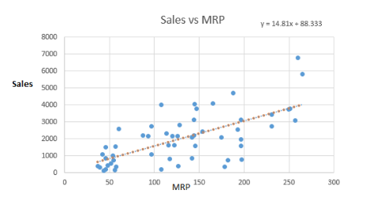
Sales VS MRP

Slide 10
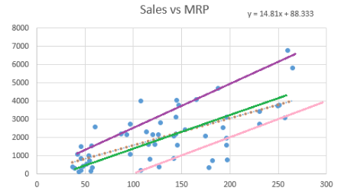
We can fit as many lines as we want but the question is to find the best fit line

Slide 11
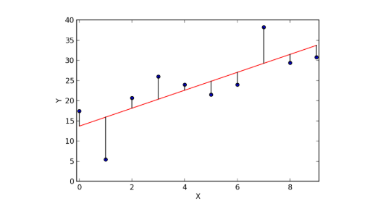
The best file is the one for which the error is less

Slide 12
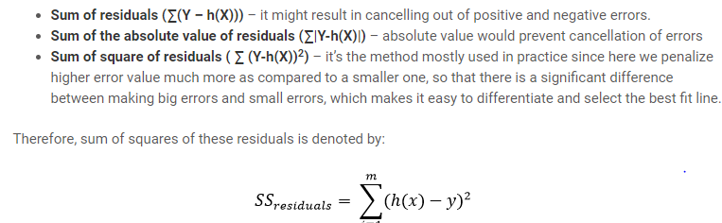

Slide 13

Model 3 – Linear Regression
Lets move to Jupyter Notebook

Slide 14
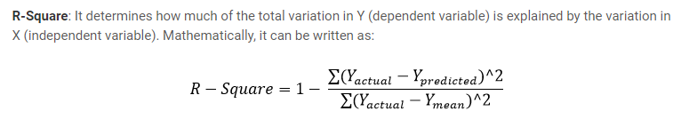
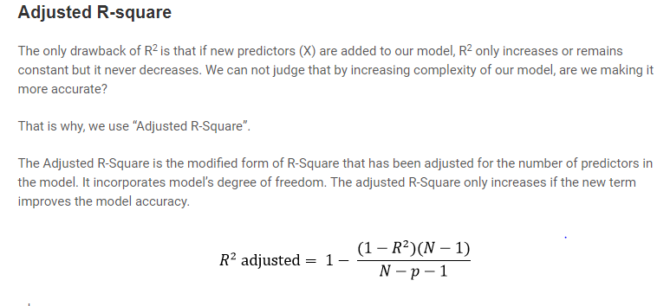
Evaluation Criteria

Slide 15
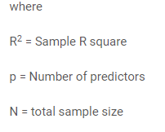

Slide 16
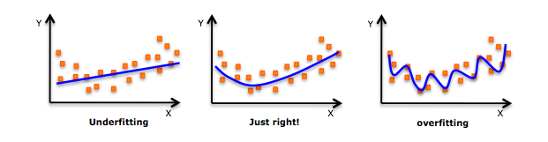
Bias and Variance

Slide 17
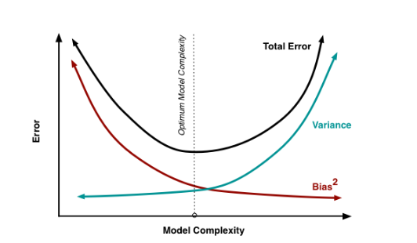
Perfect Model will find a trade-off between bias and Variance

Slide 18



www.linkedin.com/in/aabbhishekk
abhisheksrivastava501@gmail.com

